Slide 1



Prosthetic design for ankle-foot stiffness and angle for persons with transtibial amputations
Kieran Nichols
Ph.D. Preliminary Exam
Mechanical Engineering
Advisor: Peter Adamczyk
Committee: Darryl Thelen, Aaron Dingle, Katherine Fu, Justin Williams

Slide 2
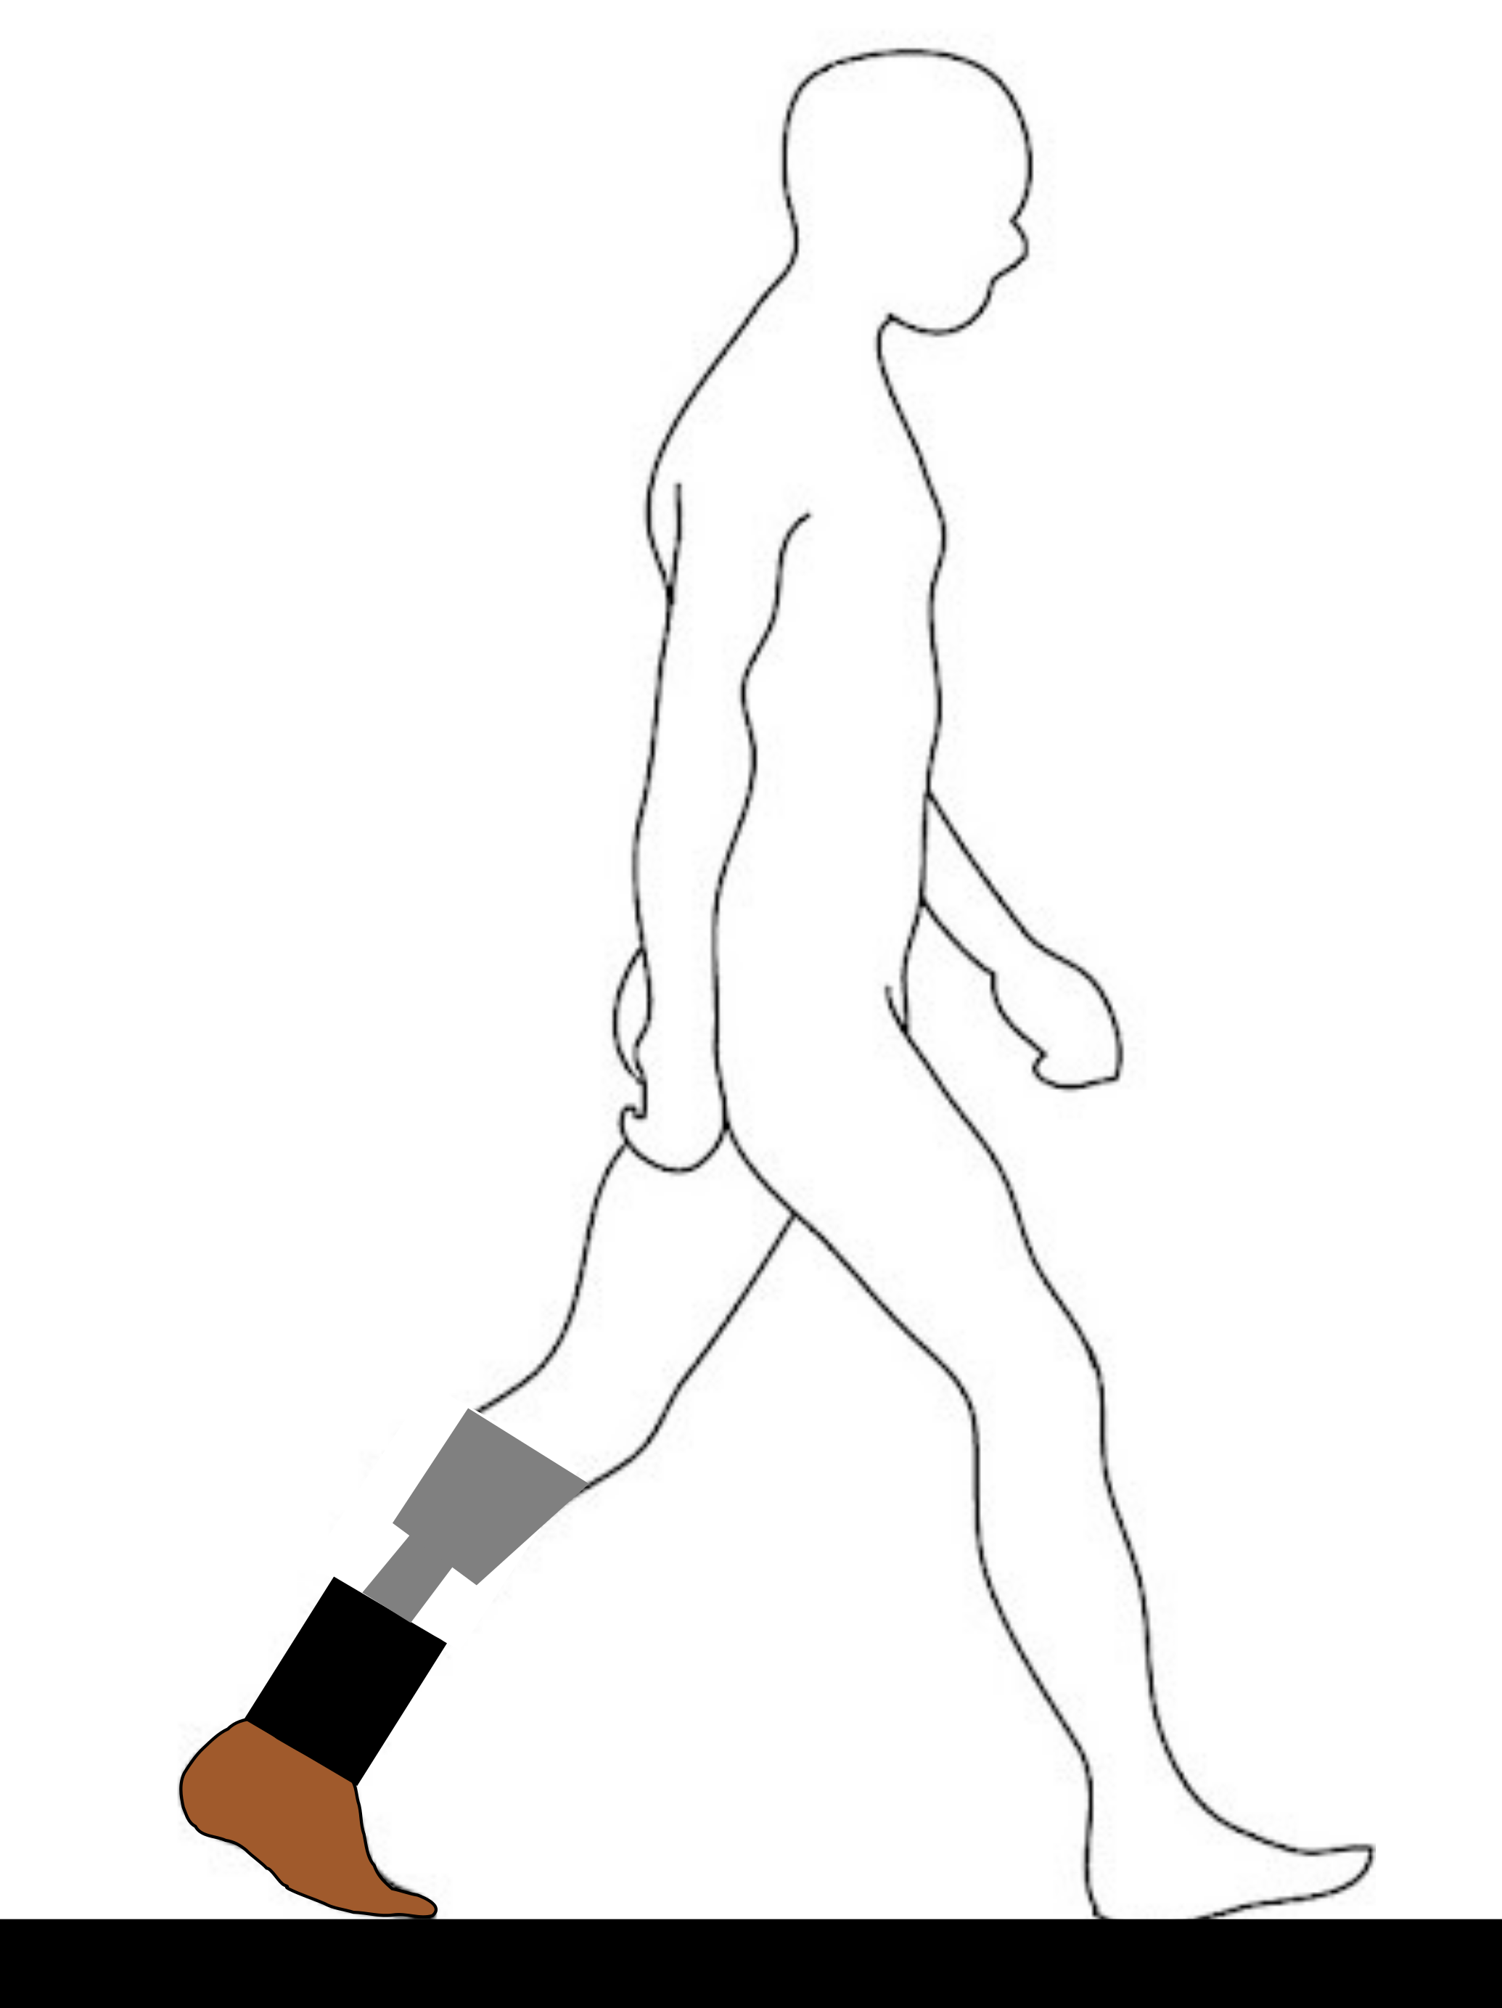
Presentation Overview
Background
Past Work
Current and Future Work
Objective
Aim and Method
Results
Discussion
Other VSF Work
Introduction
Main Principles of Prosthetic Design
Prosthetic Walking Mechanics
Lower limb sensor feedback
Objective
Aims and Methods
Timeline
Impact of Proposed Work

Slide 3
Presentation Overview
Background
Past Work
Current and Future Work
Introduction
Main Principles of Prosthetic Design
Prosthetic Walking Mechanics
Lower limb sensor feedback

Slide 4
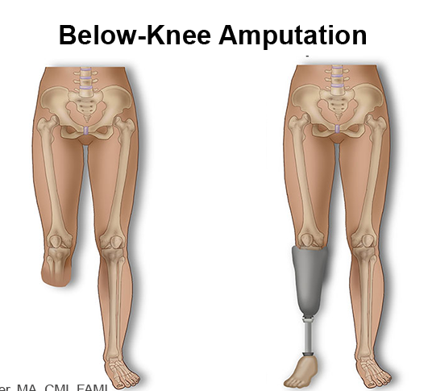
Background: Introduction
280,000 people with transtibial amputation (TTA) in the U.S^{1,2}
$1600 per year for a prosthetic device that lasts on average 1.3 years³
High cost and difficulty to recreate the human ankle-foot instigate a need for improved prostheses
Notes:
Besides the high average cost of about $81,000 for TTA amputation and associated rehabilitation services,
280 000 per year

Slide 5
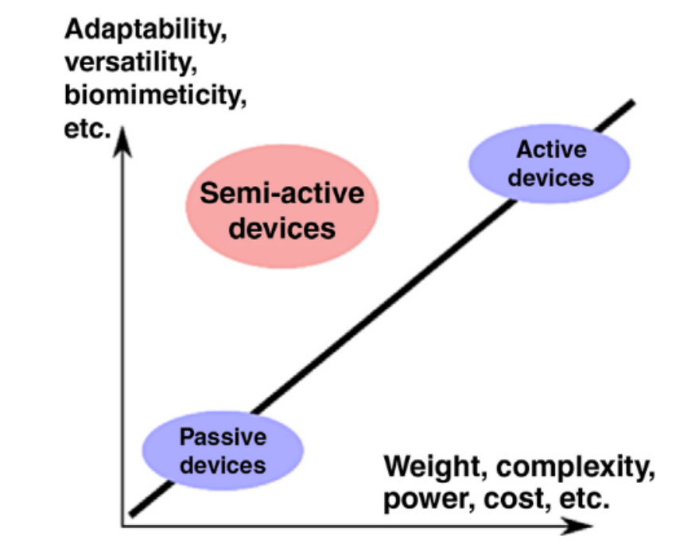
Background: Main Principles of Prosthetic Design
Two ways to describe prosthetic ankle-foot function⁴:
Ankle angular stiffness
Ankle angle control
Passive ankle-foot prosthesis replaces some of the biological structures
Semi-active prostheses attempt to recover more of the biological ankle mechanics.

Slide 6
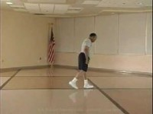
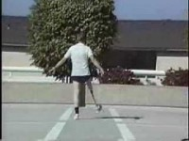
Background: Prosthetic walking mechanics
Person with transtibial amputations (TTA) have typical gait deviations of
hip circumduction
prosthetic-side hyperextension
Others include
Toe scuffing, lateral trunk bending, heel rise
Notes:
Knee hyperextension-walking uphill sensation
higher intact side collision work
weak prosthetic side push-off
toe scuffing,
Maybe another slide

Slide 7
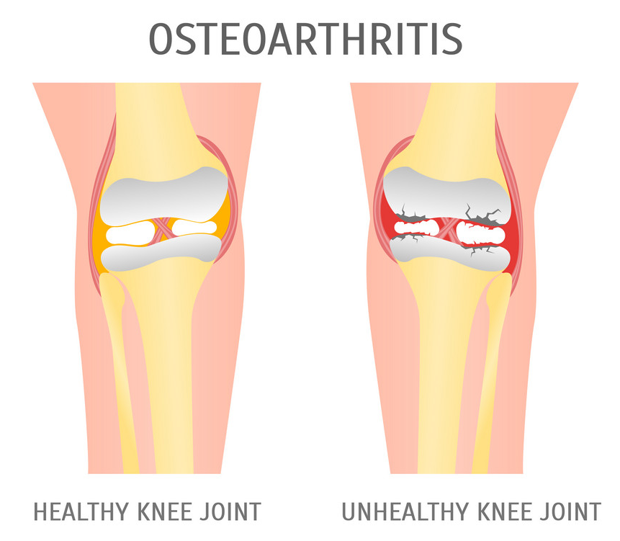
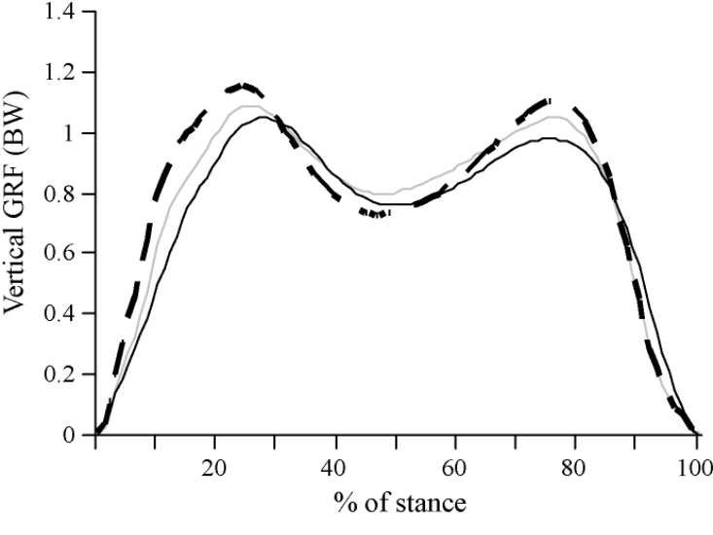
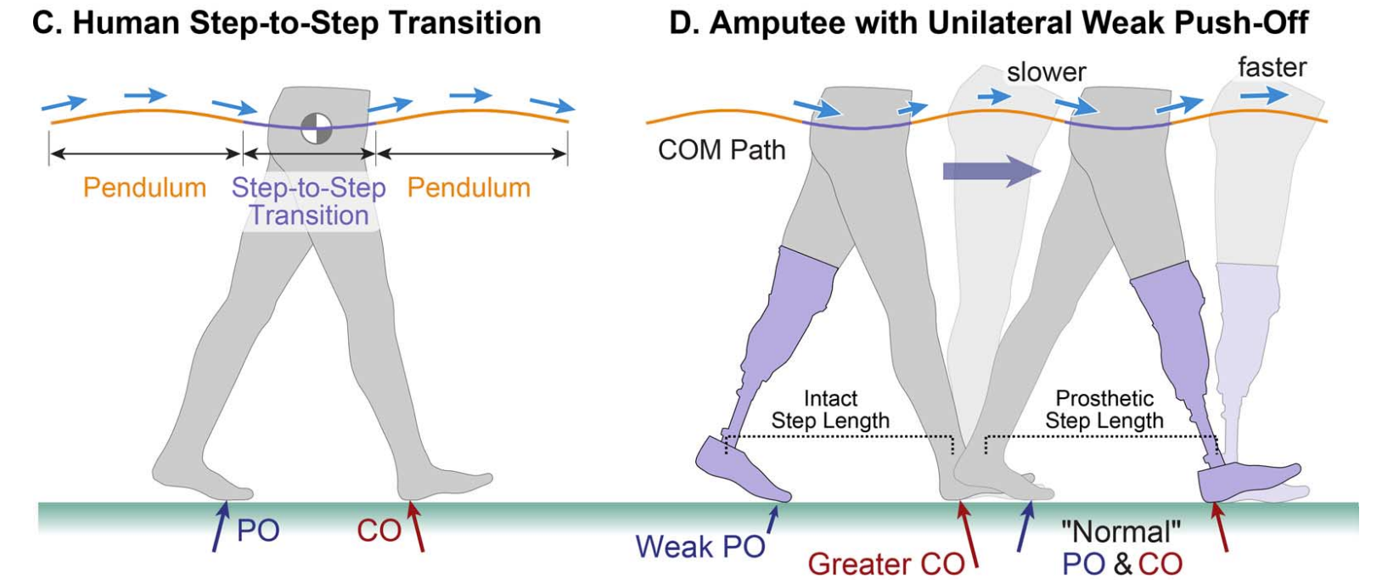
Background: Prosthetic walking mechanics
Biomechanical reasoning
Weak prosthetic push-off, higher intact side collision work
Gait asymmetry
One Consequence of the gait deviations
knee osteoarthritis on the intact side
Gray – Non-disabled
Black solid – Prosthetic-side
Black dashed – Intact-side
Notes:
Cartoon osteoarthritis healthy and unhealthy knee Vector Image (vectorstock.com)

Slide 8
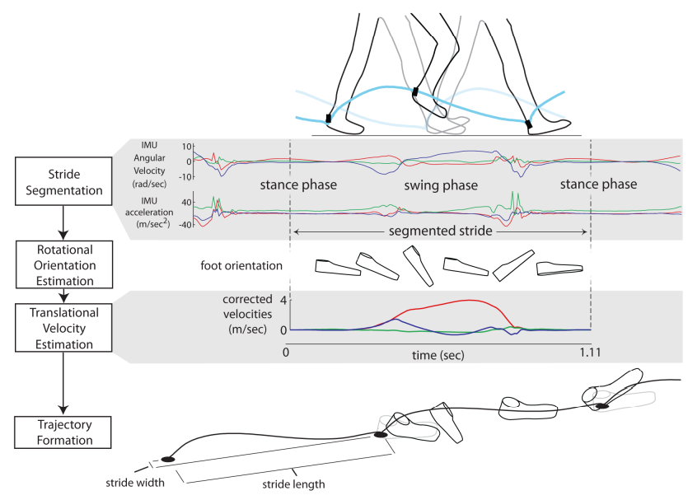
Background: Lower limb sensor feedback in prosthetic walking
using inertial measurement units and load cells to detect the prosthetic state
estimating gait events like heel strike, toe-off, and leg swing
reconstructing prosthetic movement and forces
using sensor feedback to adjust ankle-foot stiffness and angle
Notes:
Picture bigger; few worded bullet point under
Rectangles to highlight what I’m talk; pop up bullet when I talk about it
and joint moments; classifying if the gait is over flat or sloped ground

Slide 9
Background: Dissertation objective
Design and Evaluate
Stiffness and Ankle angle control
Variable Stiffness Foot (VSF) and Two-Axis aDaptable Ankle (TADA)
Notes:
These semi-active prostheses will be built to sense ankle angle, foot motion, and ankle moments using intrinsic position sensors, an IMU, and a load cell.
Though these prosthetic sensors are limited to detecting ankle kinematics and kinetics, data will also be collected for the knee, hip, and summative mechanics to

Slide 10
Presentation Overview
Background
Past Work
Current and Future Work
Objective
Aim and Method
Results
Discussion
Other VSF Work
Notes:
Picture of prosthetic walker for background, VSF for past work, TADA for current and future work

Slide 11
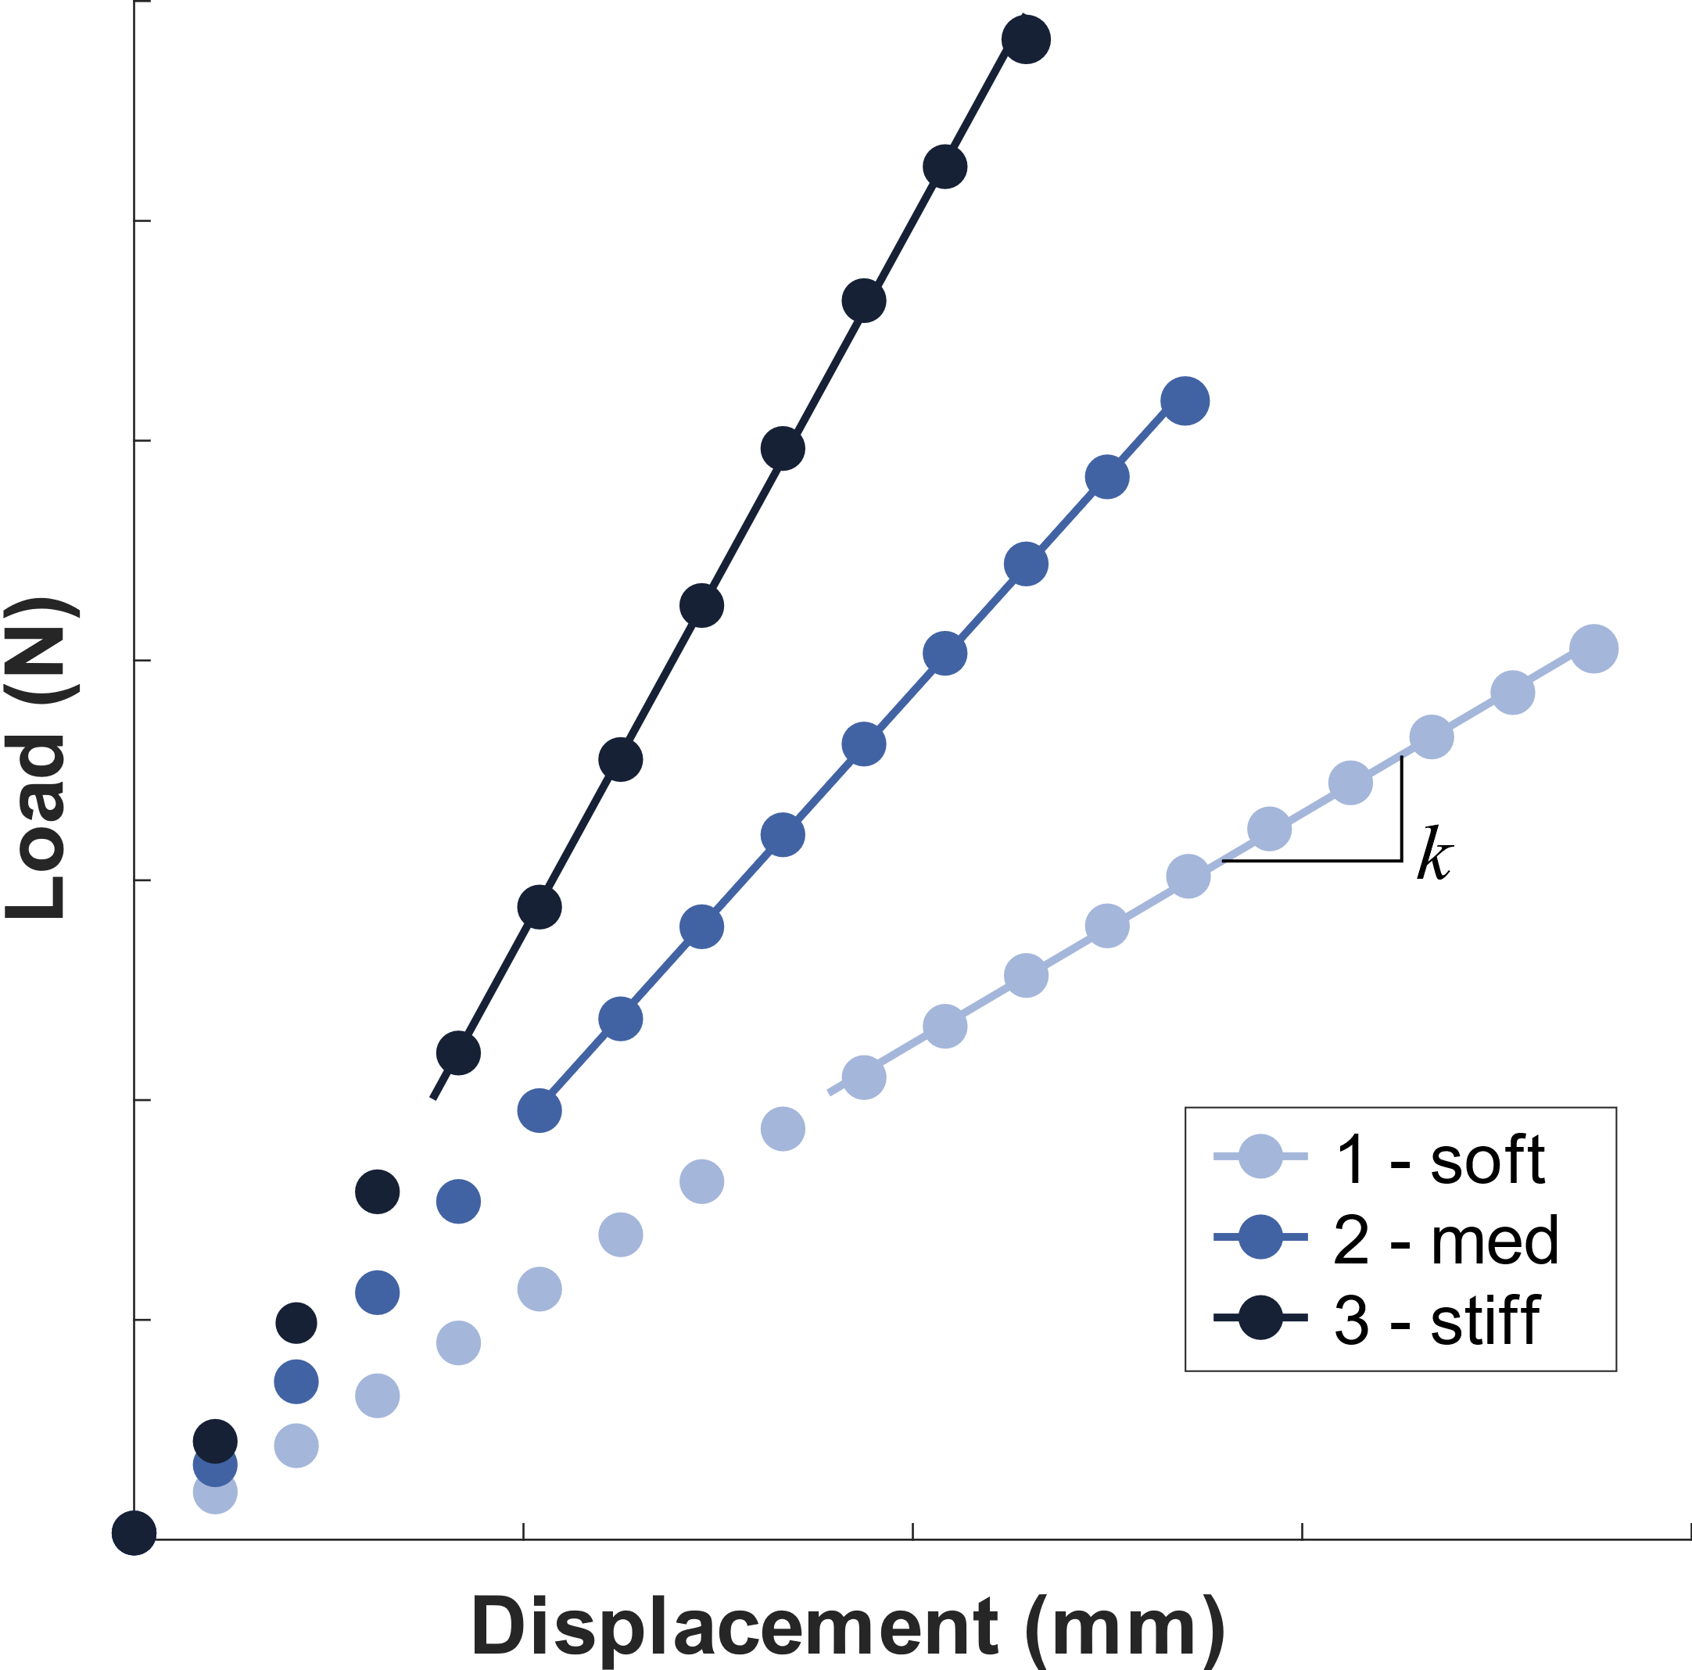
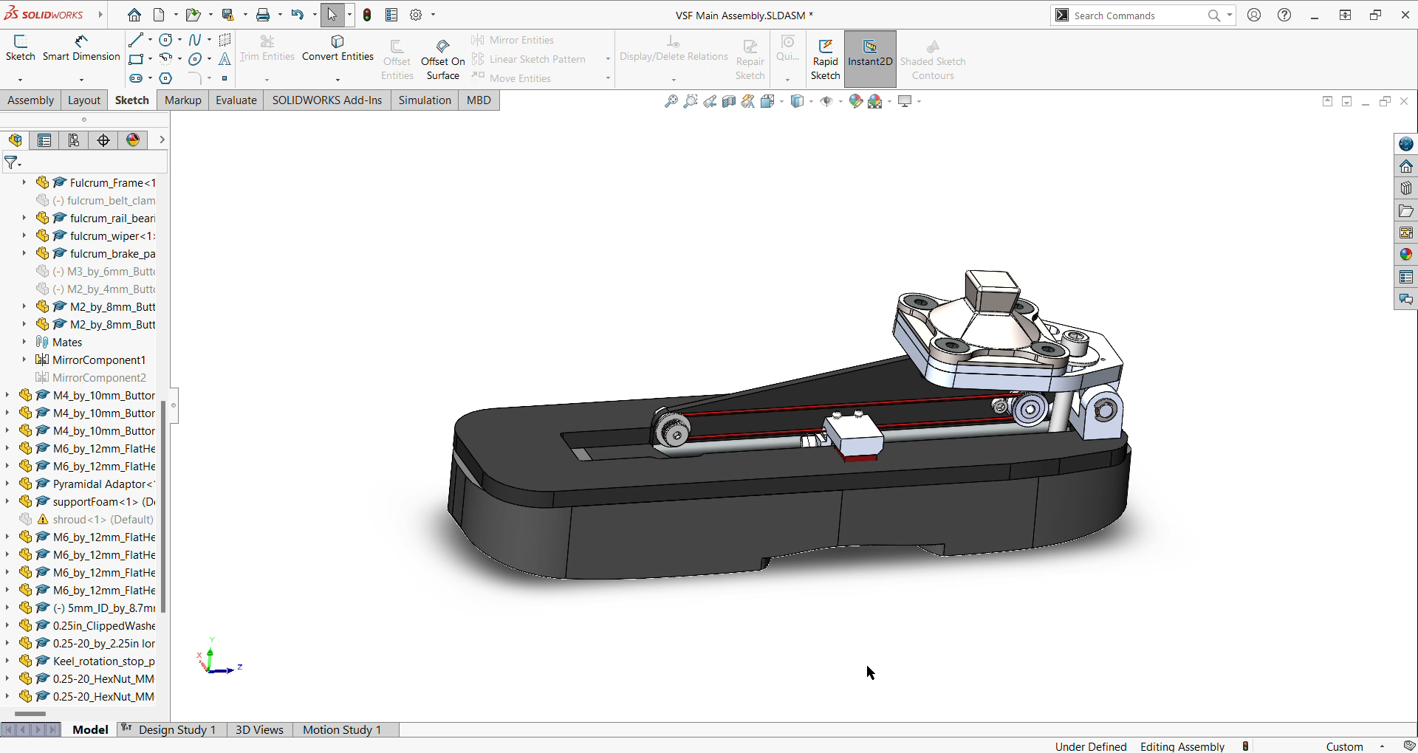
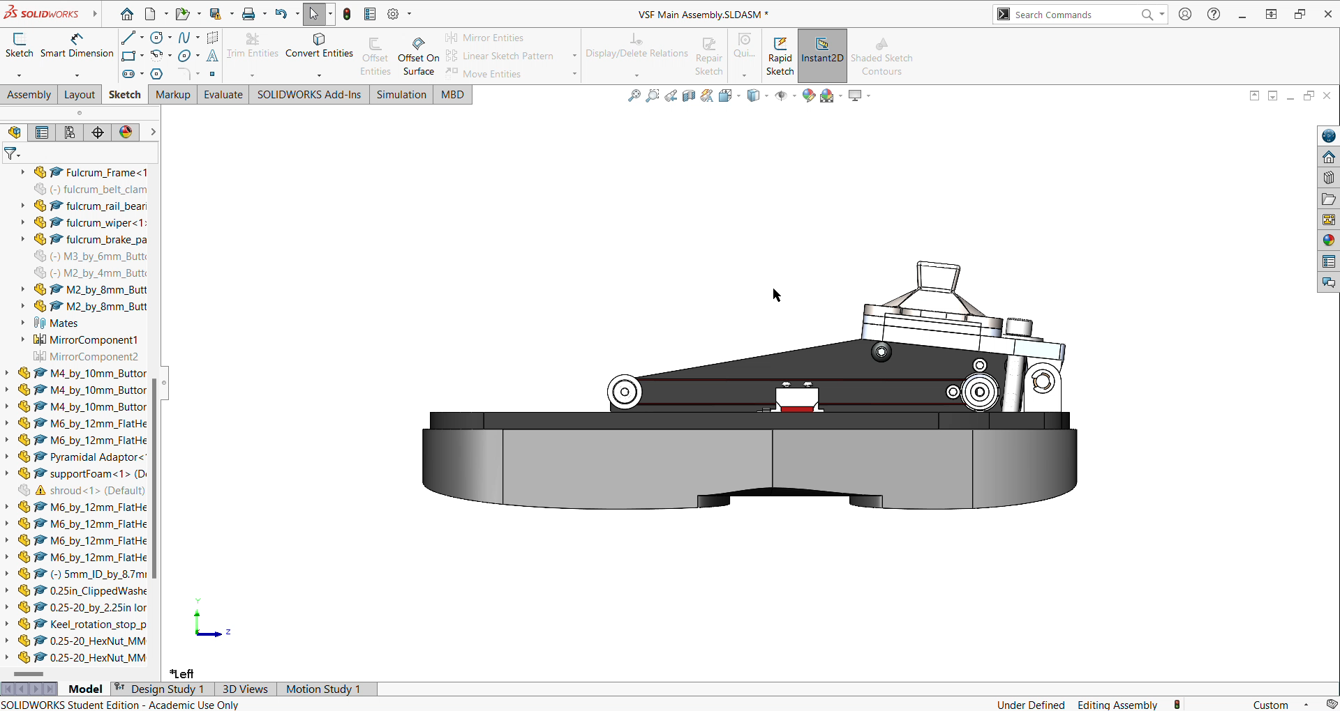
Past Work: Introduction
Variable Stiffness Foot (VSF)⁵
modulate the forefoot stiffness
semi-active device
Notes:
Clearer photo and video of VSF in action
has a rigid ankle and its forefoot acts as an overhung beam and adjust a support fulcrum to change the overhang length.
where power is not supplied to move the body while the foot is on the ground, but minimal power is supplied when the foot is in the air to move the fulcrum while the motor load is low.

Slide 12
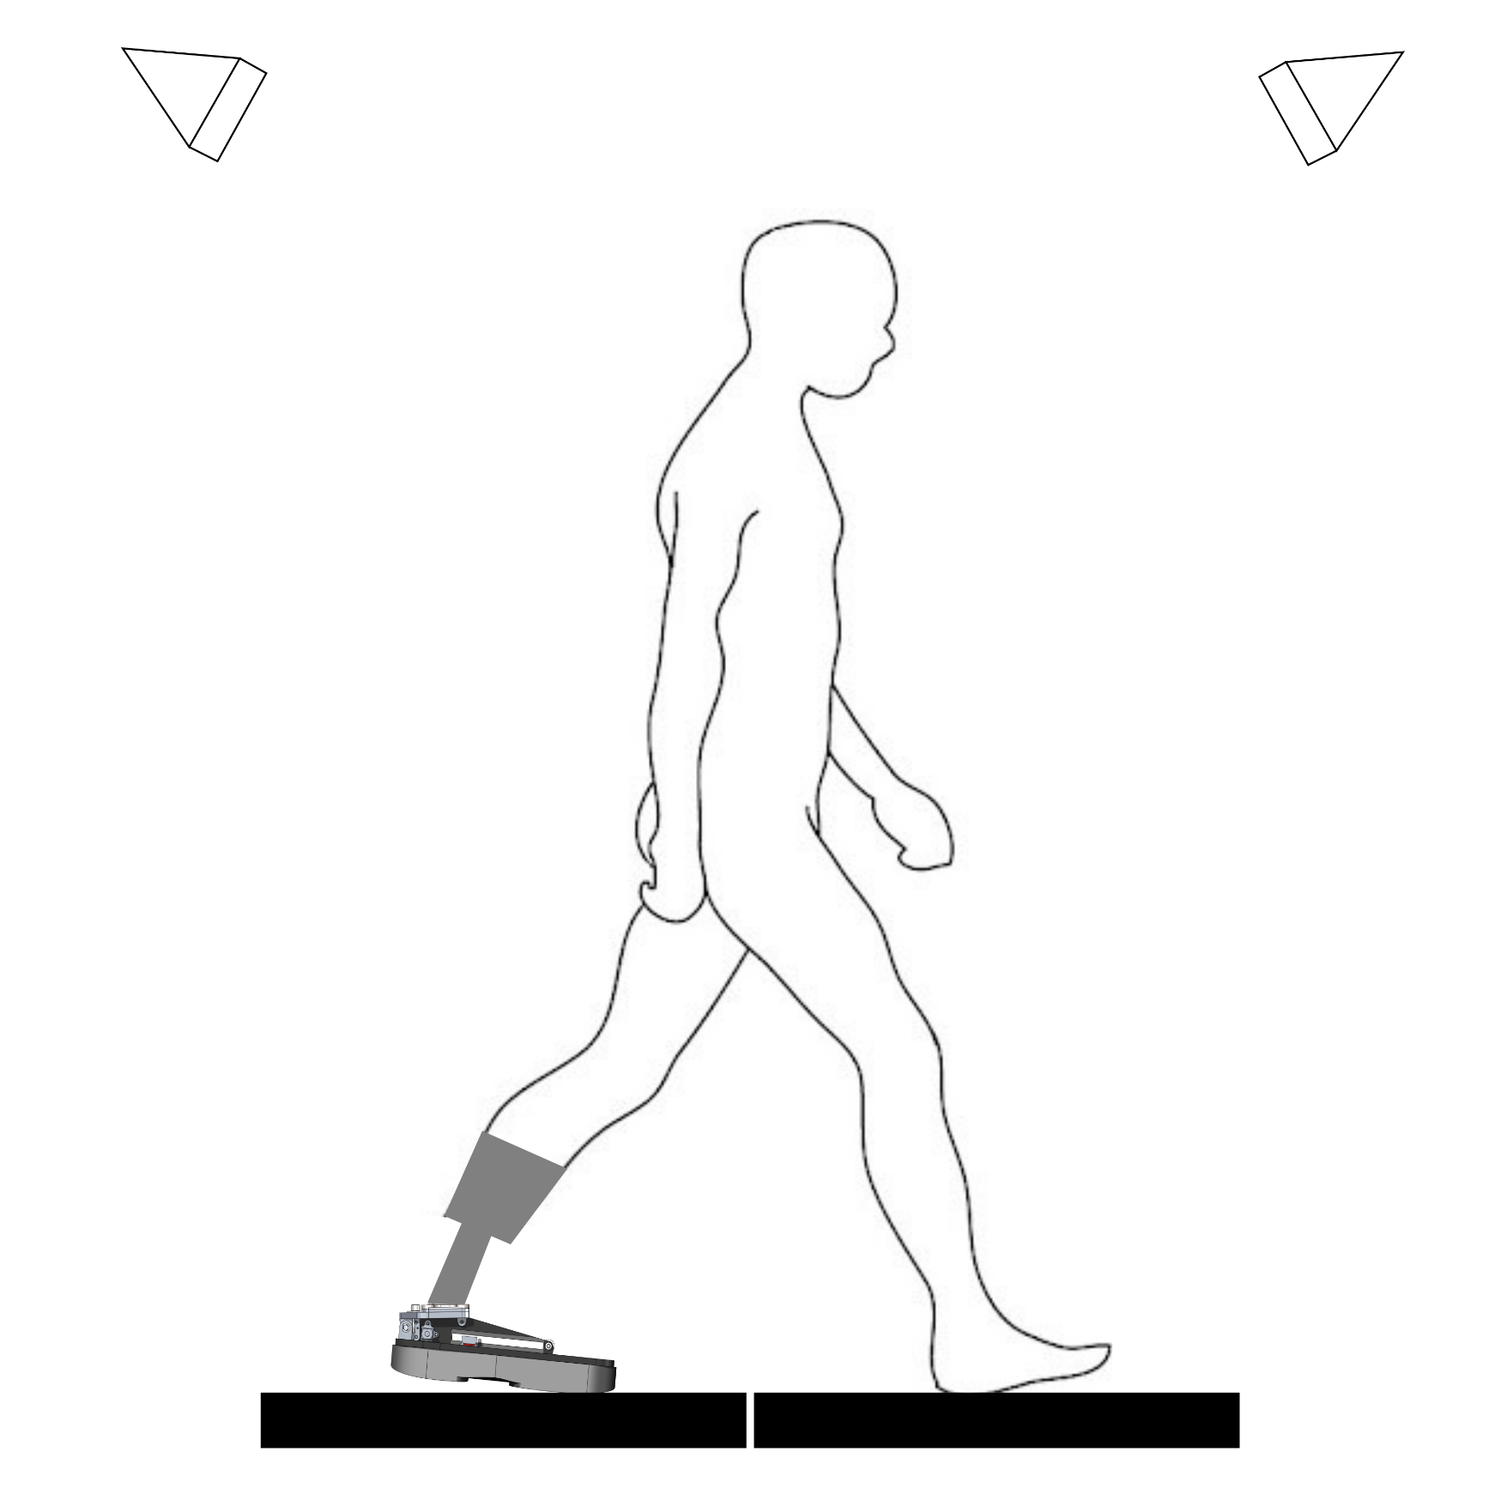
Past Work: Aim and Methods
Motion capture cameras
To evaluate the effect of various stiffness of VSF on joint mechanics in level-ground walking
Seven subjects
Walked at 1.1 m/s
Compliant, Medium, Stiff
Three successful trials per stiffness
Prosthetic socket
VSF
Force plates
Notes:
Clearer photo and video of VSF in action
This study focuses on characterizing the kinetic and kinematic response of participants with transtibial amputation in level overground walking, using the VSF at three different stiffnesses.
The participants performed nine over-ground walking trials at 1.1 ± 0.1 m/s with three different VSF stiffness settings (Compliant, Medium, Stiff)

Slide 13
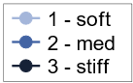
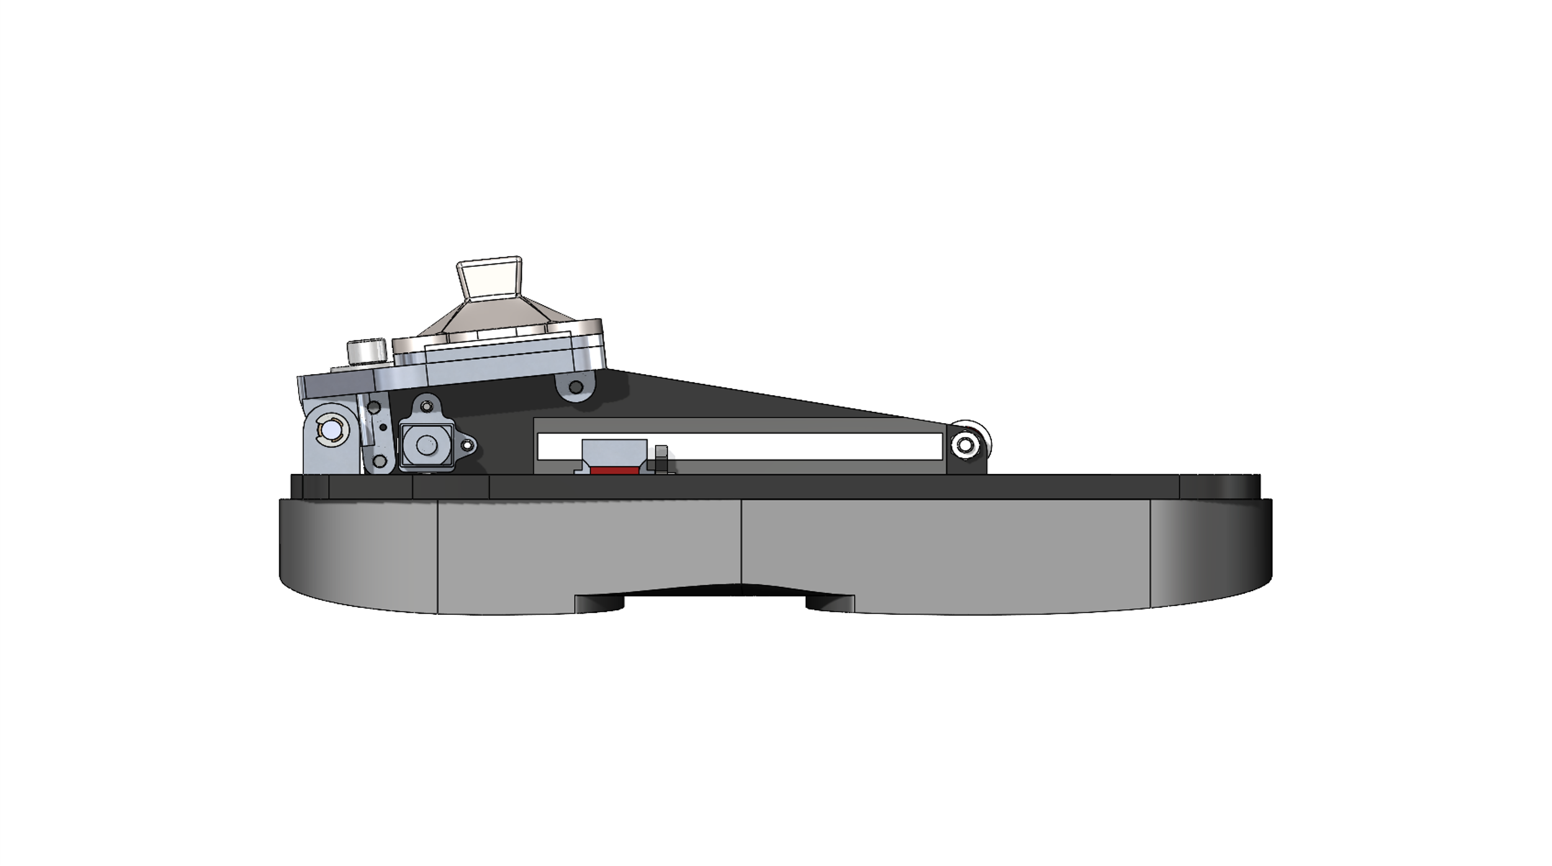
Past Work: Results
With stiffer VSF, peak magnitudes of
stance ankle angle decreased
knee flexor moment increased
the vertical ground reaction force and its off-loading rate didn’t change
Prosthesis (UD) energy storage, energy return, and power decreased
Notes:
Clearer photo and video of VSF in action
Put raw data graph and highlight important key points.
Put arrows to indicate less or more for 3 key metrics (maybe all parts of UD power)
For paper standard 3*3 with hip stuff

Slide 14
Past Work: Discussion
People with TTA tend to prefer less-stiff prostheses due to the dominance of kinetics (forces) over kinematics (movement)
A less stiff (softer) VSF related to
more prosthetic energy return
lower collision work
lower joint loads (ankle and knee moments)
potentially lower risk of knee osteoarthritis
Notes:
Clearer photo and video of VSF in action

Slide 15
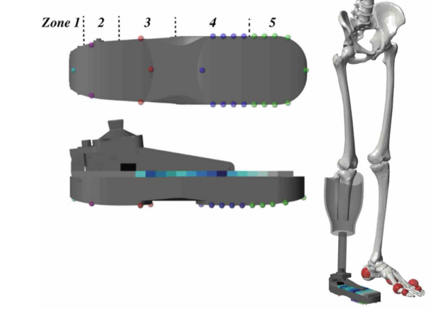
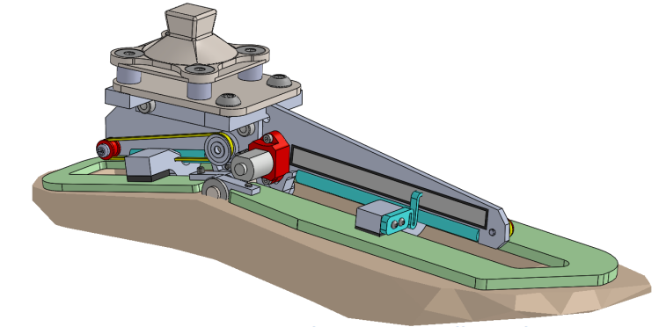
Past Work: Other VSF work
A VSF computational contact model⁶
replicated energy return and storage properties
predicted the resultant and center of pressure of the ground reaction force under the prosthesis
A Variable Stiffness Foot with 2 Keels: VSF2K
Notes:
Clearer photo and video of VSF in action
Fig. 1. Conceptual model of walking and compensations for push-off asymmetry. (A) Symmetrical model experiences sharp changes in COM (body center-ofmass) velocity (small arrows) in the step-to-step transition. Impulsive push-off (PO) from the trailing leg and impulsive collision (CO) of the leading leg redirect the COM velocity from forward-and-down to forward-and-up (dotted lines), performing positive and negative work, respectively, on the COM. (B) In the asymmetric model, weak push-off from one leg (Prosthetic, lighter shading) results in greater collision and lower speed during the ensuing (Intact) stance phase. The model can compensate by adding work through the stance hip to accelerate. Despite this acceleration, speed during middle-stance is slower on average during Intact stance than during Prosthetic stance. (C) In humans, step-to-step transition is not perfectly impulsive but COM velocity experiences similar fluctuations. (D) Unilateral amputees have weak push-off, which is expected to lead to greater collision, slower middle-stance speed, and greater compensatory work on the intact leg. Step length asymmetry is also possible, defined here between contact points for the model (B) and between ankles for humans (D).

Slide 16
Presentation Overview
Background
Past Work
Current and Future Work
Objective
Aims and Methods
Timeline
Impact of Proposed Work
Notes:
Picture of prosthetic walker for background, VSF for past work, TADA for current and future work

Slide 17
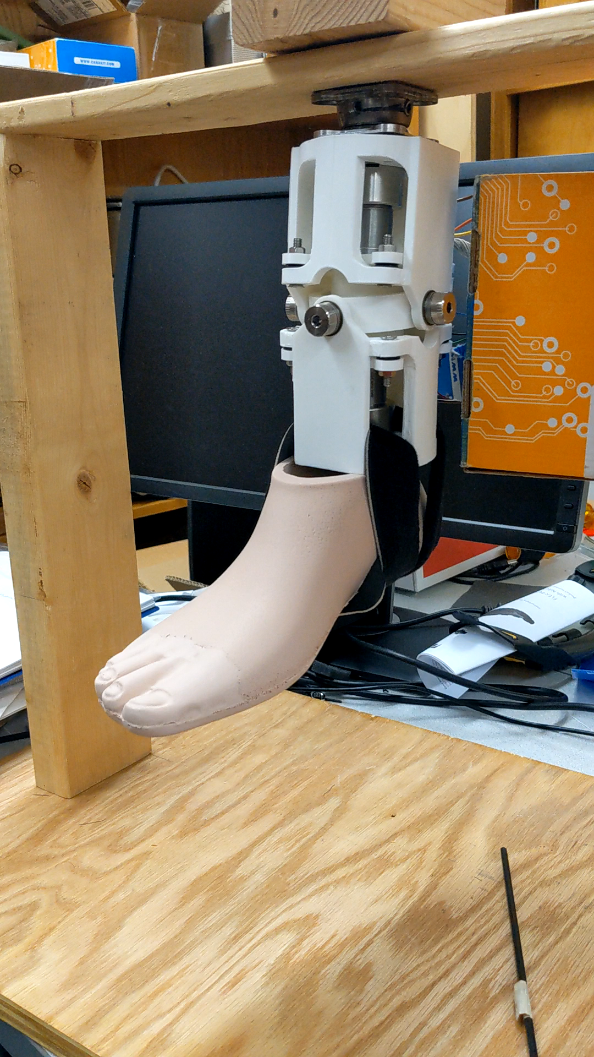
Current and Future Work: Two-Axis aDaptable Ankle
The Two Axis aDaptable Ankle (TADA) is a semi-active ankle prosthesis
independently modulate two axes of ankle angles (±10°, sagittal and frontal)
prevent rotations of the attached foot when the motor shaft is not moving
Notes:
https://uwbadgerlab.engr.wisc.edu/wp-content/uploads/sites/727/2019/07/TADA-Supplemental-Video1_small.mp4?_=1

Slide 18
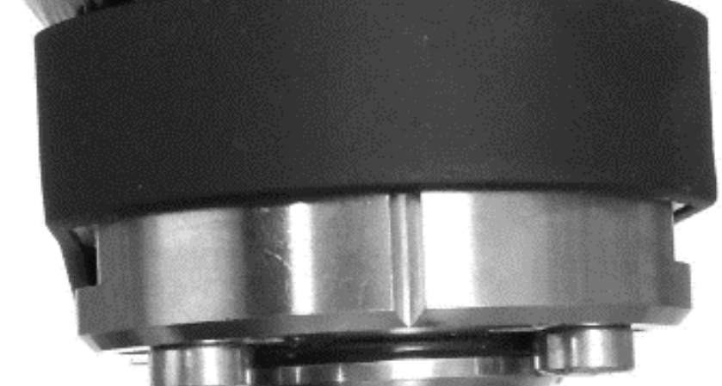
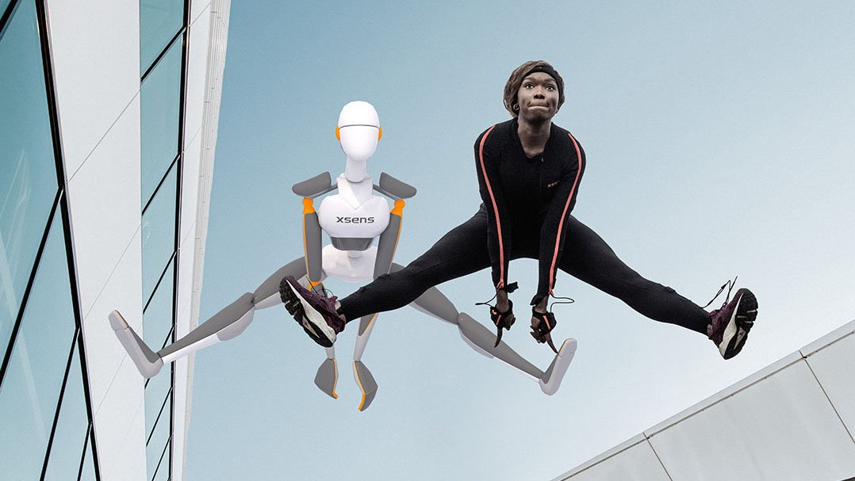
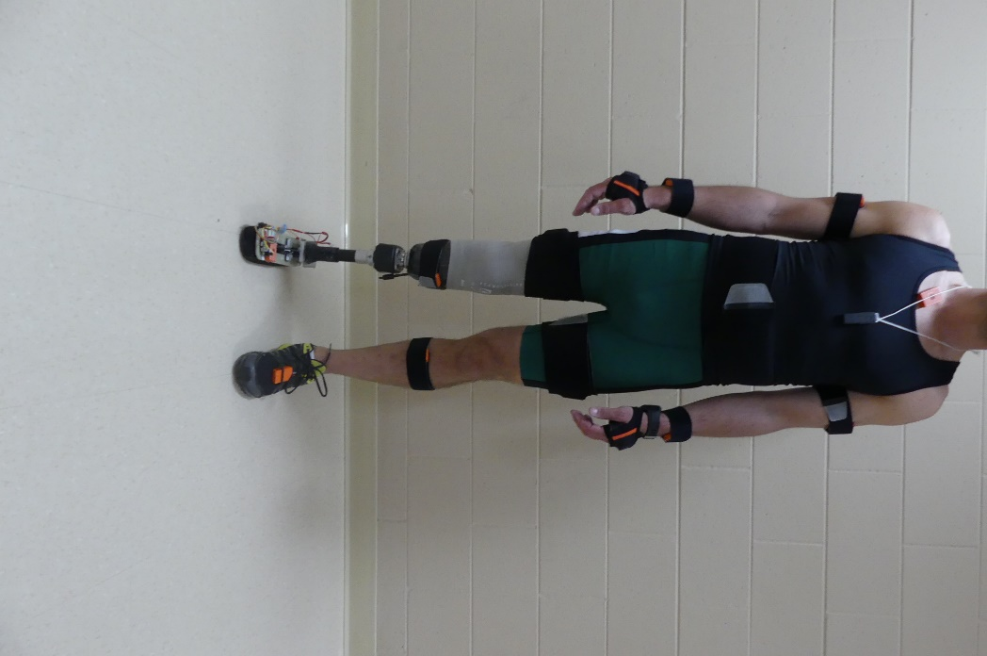

Current and Future Work: Instrumentation
TADA-specific
Load cell
Motors with position sensors
Wedge mechanism
Foot and IMU
Body-specific
Xsens IMU suit
Motion capture and force plate
Notes:
Need a better way to describe rather than primary and secondary.
Graphic of set-up on human?
Picture of each specific set-up?

Slide 19
Current and Future Work: Overview of Aims and Methods
Aim 1: Develop and test the validation of the TADA controller
Aim 2: Evaluate the biomechanical effects of the TADA on out-of-the-lab walking while having the main control laws of
lifting the toe during every swing phase
anticipatory slope-matching control
moment-limiting control

Slide 20
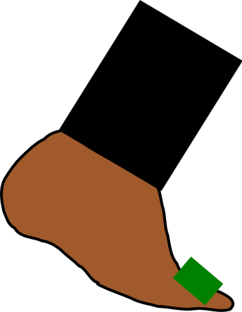



Current and Future Work: Main Control Laws
Ankle Moment
TADA
IMU
Foot angle from the floor
Toe-lift
Ɵ
Toe-lift control
Anticipatory Slope-Matching Control
Moment-Limiting Control
Notes:
Diagram for each

Slide 21


Current and Future Work: Comparisons
Intact
Ankle
Fixed Ankle
VS.
VS.
Adaptable Ankle
Adaptable Ankle
Notes:
Diagram for each

Slide 22
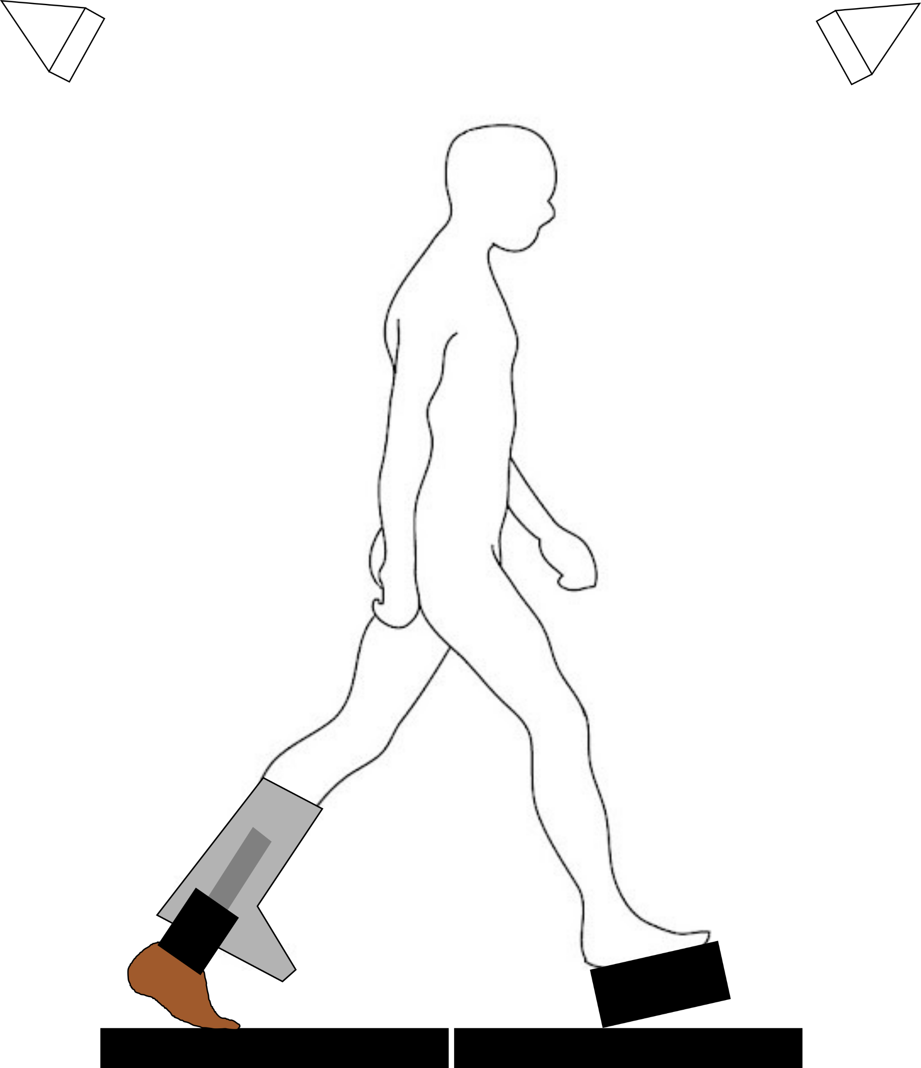
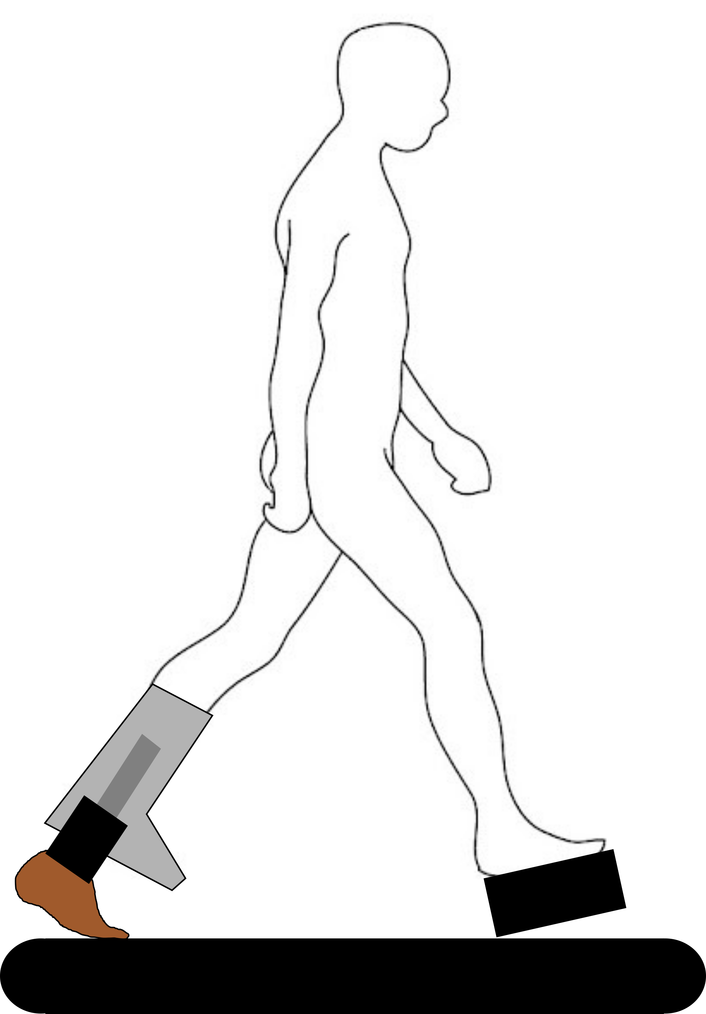
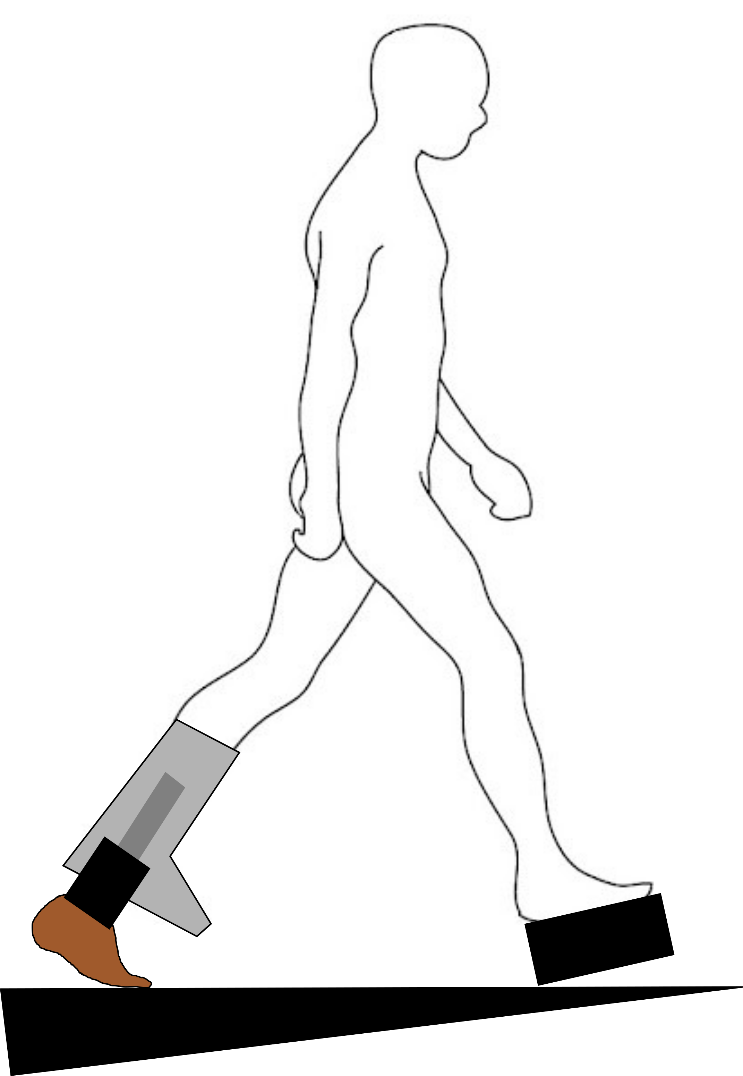
Current and Future Work: Aim 1
Develop and test the validation of the TADA controller
on four non-disabled persons (no amputations)
Motion capture cameras
Prosthetic extension orthotic
TADA
Elevator sole
Force plates
Speed of 0.9, 1.1, 1.3 m/s
Treadmill
Slope of 0, -5, 5 degrees
Ramp
Slope of -5 and 5 degrees
Notes:
The kinematic aim hypothesizes that there will be no difference between the control of the prosthetic ankle angle and the intact ankle angle trajectory during the swing phase, and that there will be no difference between the mean prosthetic ankle angle and the pre-recorded ground slope during the stance phase. The kinetic aim hypothesizes that the means of the sagittal and frontal prosthetic ankle moments will be less than a fixed neutral ankle’s means.
Diagram of non-disabled person

Slide 23
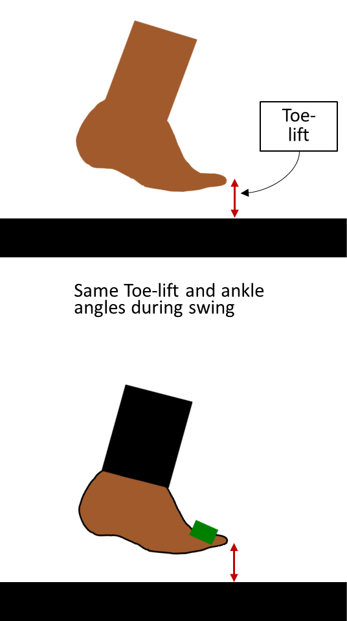
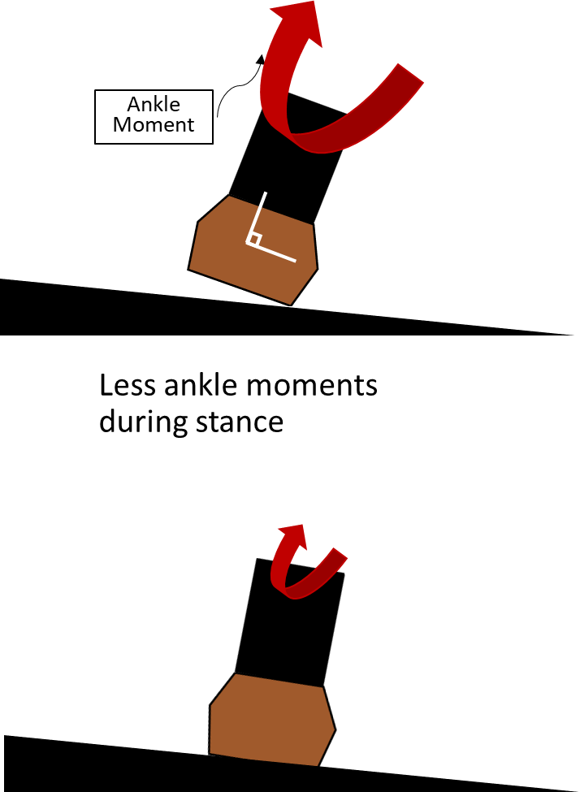
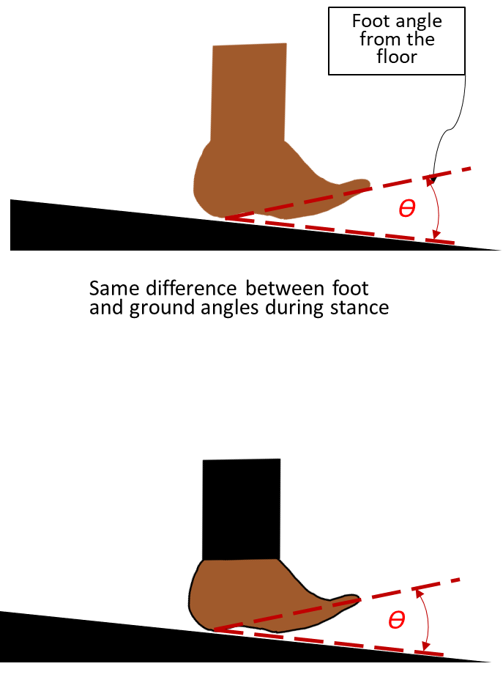
Current and Future Work: Aim 1
Intact or Fixed Ankle
VS.
Adaptable
Ankle
Notes:
Diagram for each

Slide 24
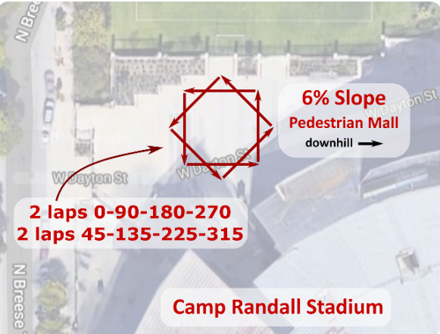
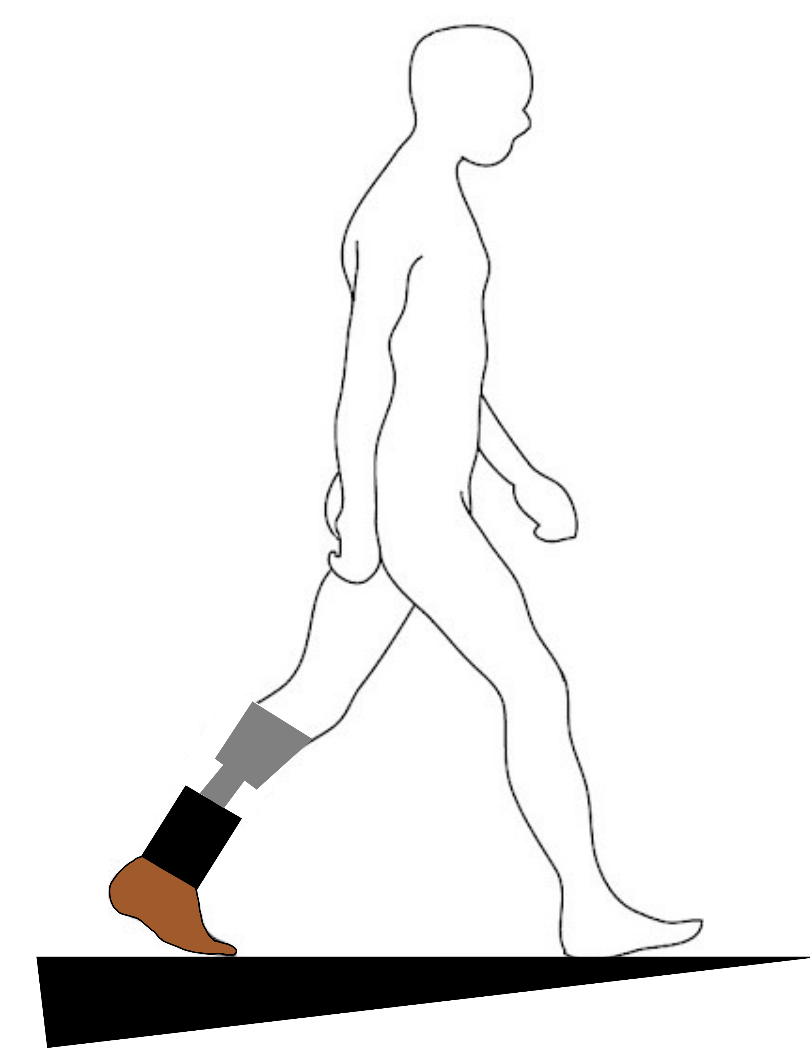
Current and Future Work: Aim 2
Map from TADA grant: Congressionally Directed Medical Research Programs (CDMRP) Search Awards. https://cdmrp.army.mil/search.aspx?LOG_NO=DM190827.
Evaluate the biomechanical effects of the TADA on out-of-the-lab walking on ten persons with transtibial amputations
Prosthetic socket
TADA
Toe lift controller
(0, -5, 5 degrees)
Anticipatory slope-matching controller (uphill, downhill, cross-hill, diagonal)
Moment-limiting controller (uphill, downhill, cross-hill, diagonal)
Notes:
Self-selected speed

Slide 25
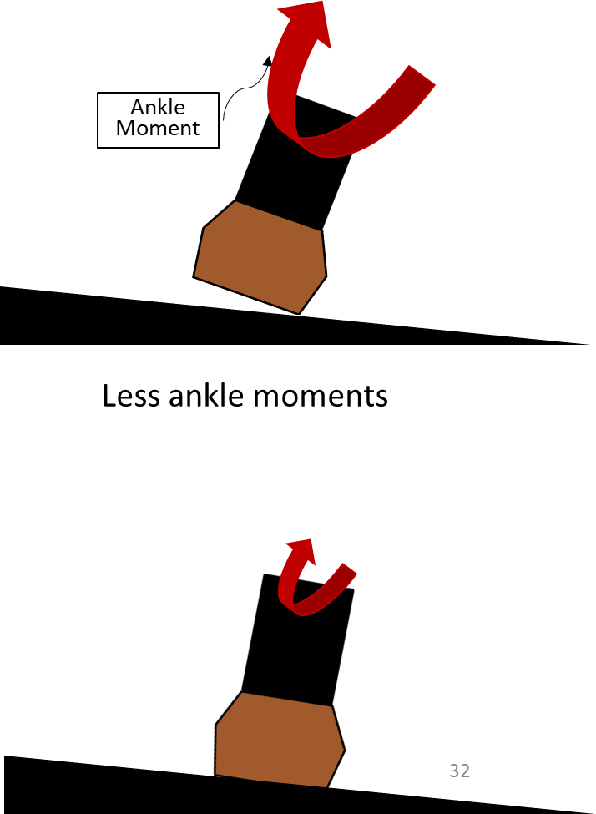
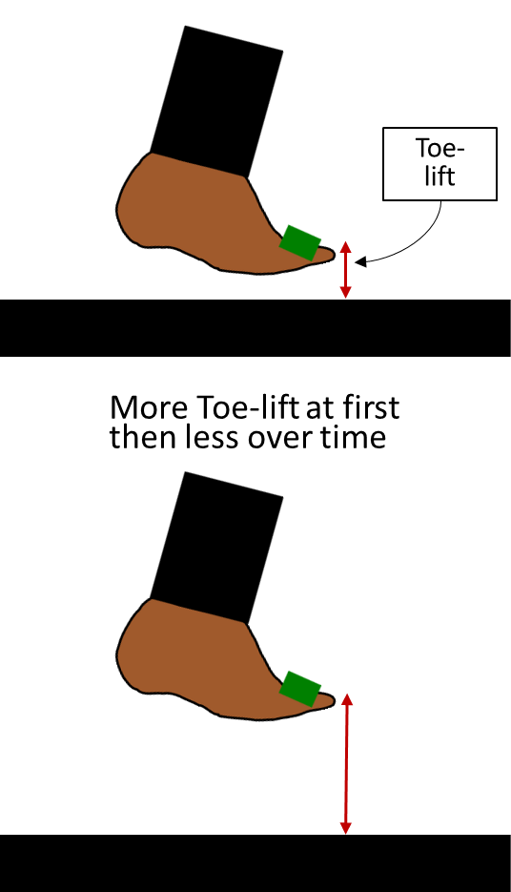
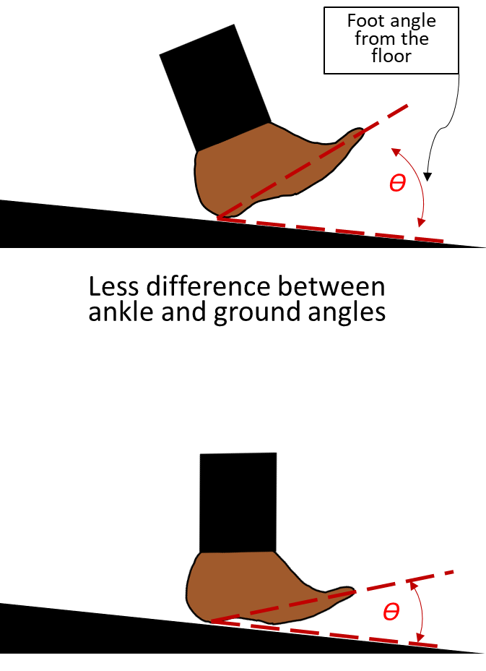
Current and Future Work: Aim 2
Fixed ankle
VS.
Adaptable Ankle
Notes:
Diagram for each

Slide 26





Dissertation timeline
07
Defense
Defend dissertation
Q4 2023
06
End of PhD
Write and prepare for dissertation defense
Submit manuscripts
Conference
Q1 2023
Present
05
Aim 2
04
Aim 1b
Recruitment
Data collection
Data analysis
Conference
03
Aim 1a
Prototyping and software development
Data collection
TADA preparation
Q1 2022
Past work
Prototyping and software development
Data collection
Helped with TADA re-desgin
Tested old TADA for motor parameters for new design
Ordered TADA electronics
Developing the software controller for the TADA system
Collected and processed VSF data
Started writing VSF manuscript
Helped with VSF grants
Helped submit 2 VSF collaboration papers
Q3 2022
Q2 2022
Q4 2020
Q1 2020
Q1
Q2
Q3
Q4
Q1
Q2
Q3
Q4
Q1
Q2
Q3
Q4
Q1
Q2
Q3
Q4
Pre-2021
2021
2022
2023
Notes:
Mention update in schedule not included in written document

Slide 27
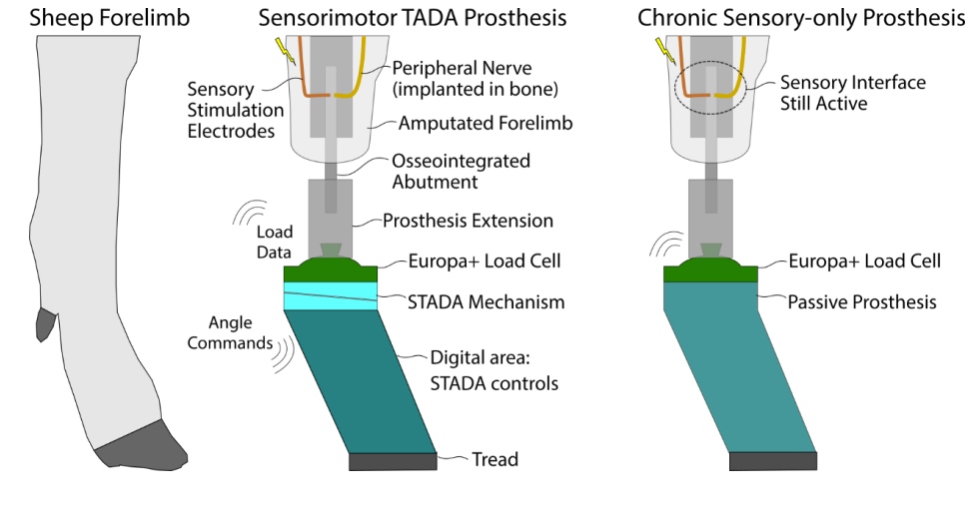
Current and Future Work: Impact of Proposed Work
Sensing locomotion modes and transitions
Combine with other semi-active prostheses like the VSF2K
Next step will the STADA (Sheep TADA):
osseointegrated
bidirectional neural interface
Figure of STADA: Congressionally Directed Medical Research Programs (CDMRP) Search Awards. https://cdmrp.army.mil/search.aspx?LOG_NO=DM190827.
Notes:
The main aim of the STADA work will be to demonstrate proof of principle that a semi-active and multi-axis prosthesis like the STADA could be neurally controlled
Need to include picture of STADA

Slide 28
Acknowledgement
Family and close friends
Advisor and committee
BADGER Lab and colleagues
Department of Mechanical Engineering

Slide 29
References
Ziegler-Graham, Kathryn, Ellen J. MacKenzie, Patti L. Ephraim, Thomas G. Travison, and Ron Brookmeyer. “Estimating the Prevalence of Limb Loss in the United States: 2005 to 2050.” Archives of Physical Medicine and Rehabilitation 89, no. 3 (March 2008): 422–29. https://doi.org/10.1016/j.apmr.2007.11.005.
Esquenazi, Alberto, and Stanley K. Yoo. “Lower limb amputations: epidemiology and assessment.” PMR Knowledge Now 3 (2016).
Wanamaker, Andrea B., Rebecca R. Andridge, and Ajit M. W. Chaudhari. “Projected Health Care Associated Costs of Workplace-Related Traumatic Amputation After 10, 15, and 20 Years: Part I: Lower Limb.” JPO: Journal of Prosthetics and Orthotics 31, no. 3 (July 2019): 189–198. https://doi.org/10.1097/JPO.0000000000000260.
Adamczyk, Peter Gabriel. "Semi-active prostheses for low-power gait adaptation." Powered Prostheses. Academic Press, 2020. 201-259.
Glanzer, E. M. & Adamczyk, P. G. Design and Validation of a Semi-Active Variable Stiffness Foot Prosthesis. IEEE Trans. Neural Syst. Rehabil. Eng. 26, 2351–2359 (2018).
McGeehan, Michael A., et al. "A computational gait model with a below-knee amputation and a semi-active variable-stiffness foot prosthesis." Journal of Biomechanical Engineering 143.12 (2021): 124502.
Cartoon figure of person walking throughout the presentation: http://clipart-library.com/clipart/rcnr5LrLi.htm

Slide 30
Extra material

Slide 31
Current and Future Work: Specific Aim 1
Foot angle from the floor
Ankle Moment
Toe-lift
Ɵ
Same Toe-lift and ankle angles during swing
Same difference between foot and ground angles during stance
Less ankle moments during stance
Ɵ
Notes:
Diagram for each

Slide 32
Current and Future Work: Specific Aim 2
Foot angle from the floor
Ankle Moment
Toe-lift
Ɵ
More Toe-lift at first then less over time
Less difference between ankle and ground angles
Less ankle moments
Ɵ
Notes:
Diagram for each

Slide 33
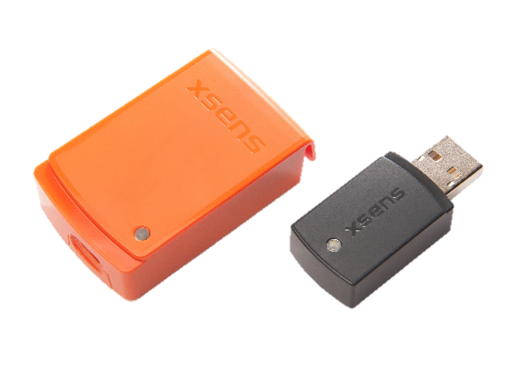
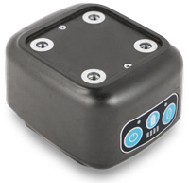
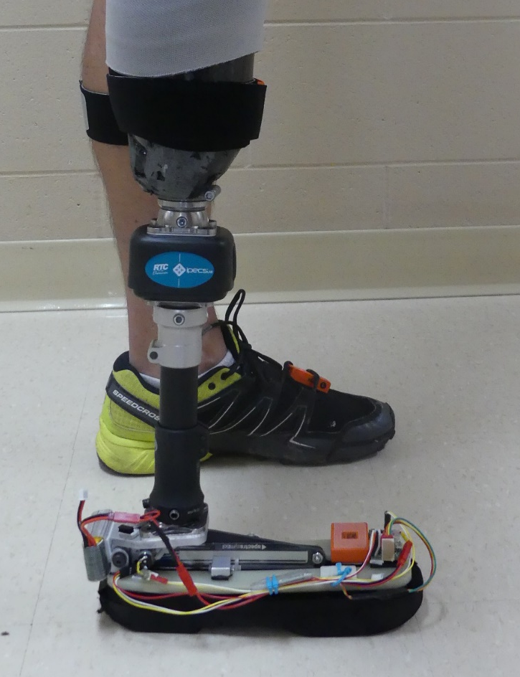
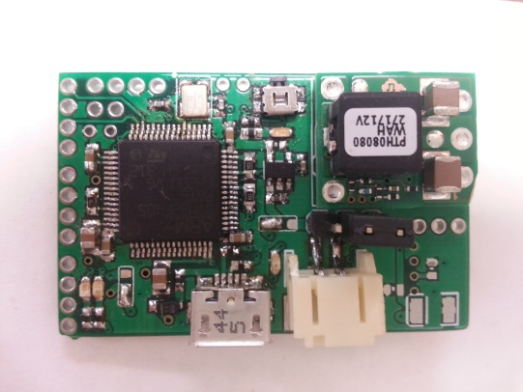
Xsens IMU Suit
Sensors
iPecs Load Cell
Microcontroller and IMU
Notes:
Need a better way to describe rather than primary and secondary.
Graphic of set-up on human?
Picture of each specific set-up?

Slide 34
Concerns
May be too much development over a short period of time
May not see enough adaptation for persons with amputations
The prosthetic ankle + electronics may be too bulky and heavy
The TADA feedback controller should be able to estimate ankle kinetics (forces), but it is not clear yet how to estimate knee kinetics to assess how persons with amputations will adapt to wearing the TADA

